Slide 1

基于MindSpore的Falcon大模型迁移与性能研究
Flash Attention-2(stage 3)
Week 15
曾子瑄
2024.02.01
Notes:
照片为学生拍摄的礼堂

Slide 2
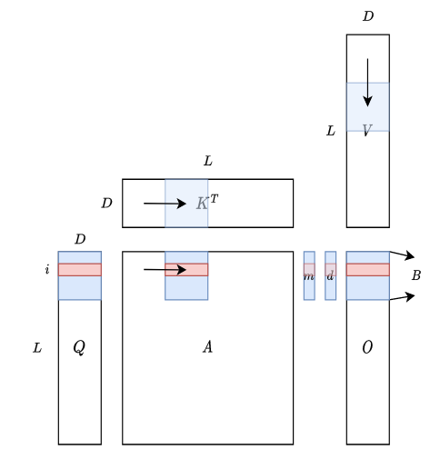
Motivation
FlashAttention is still suboptimal
The forward pass only reached 30-50% of the theoretical maximum FLOPs/s of the device.
The backward pass only reaches 25-35% of the theoretical maximum FLOPs/s of the device.
Optimized GEMM can reach up to 80-90% of the theoretical maximum device throughput.
Observation
Non-matmul FLOPs can be further reduced.
The sequence length dimention can be further parallelized.
I/O between warps and shared memory can be further reduced.
From Online Softmax to FlashAttention, Zihao Ye

Slide 3
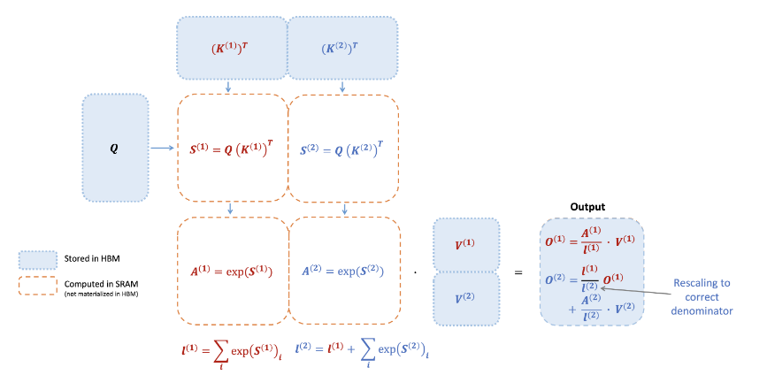
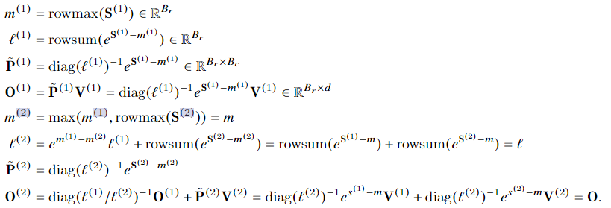
Method
FlashAttention
FlashAttention uses online softmax to enable tiling to reduce memory reads/writes.
FlashAttention Forward pass process
I/O complexity
Standard Attention | FlashAttention

Slide 4
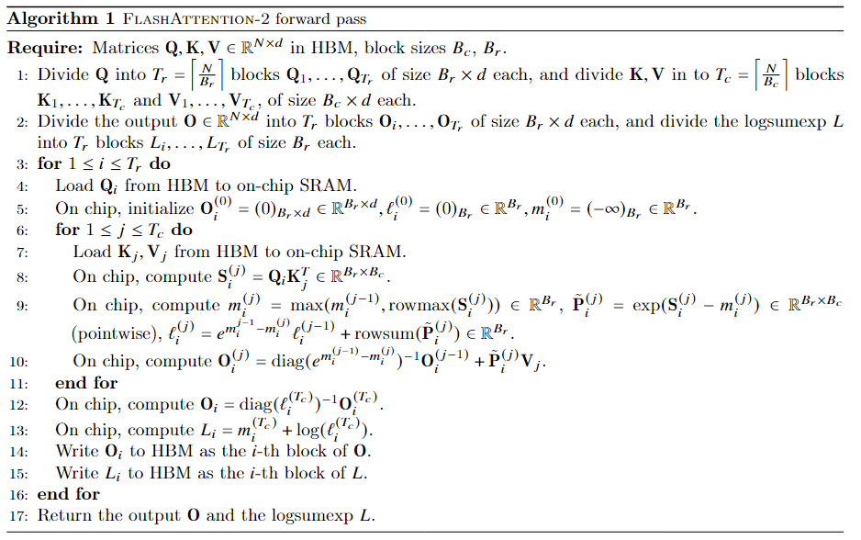
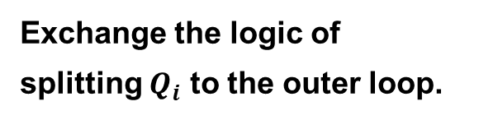
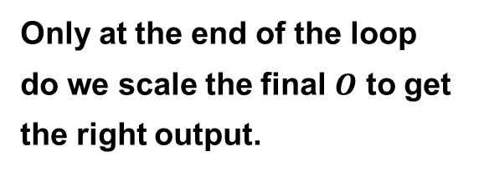
Method
FlashAttention-2
Exchange the logic of splitting $Q_{i}$ to the outer loop.
Only at the end of the loop do we scale the final $O$ to get the right output.
Only need to store the logsumexp to reduce memory overhead while maintain correnctness for the BWD pass.

Slide 5
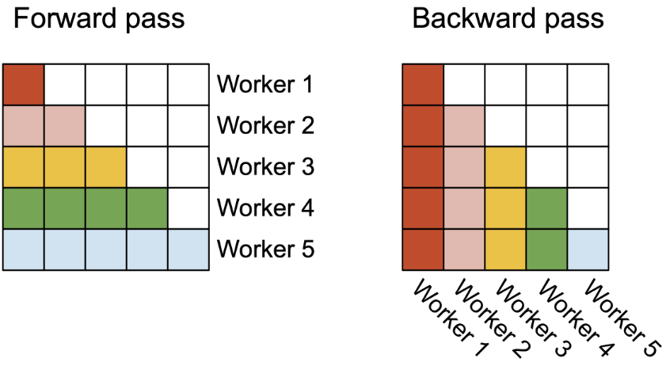
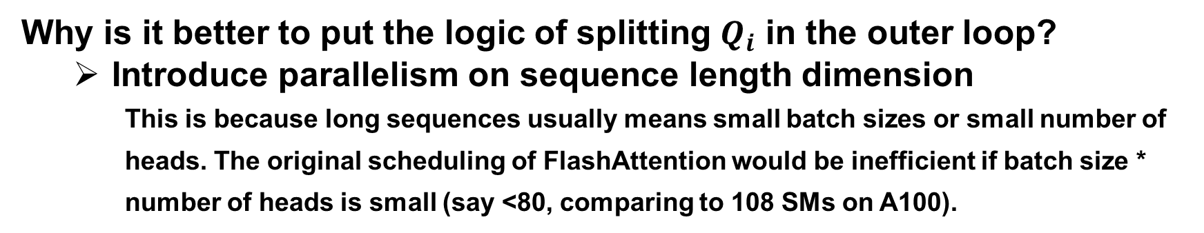
Method
Why is it better to put the logic of splitting $Q_{i}$ in the outer loop?
Introduce parallelism on sequence length dimension
This is because long sequences usually means small batch sizes or small number of heads. The original scheduling of FlashAttention would be inefficient if batch size * number of heads is small (say <80, comparing to 108 SMs on A100).
First suggested by Phil Tillet in the Triton [Tillet et. Al, MAPL 2019]

Slide 6
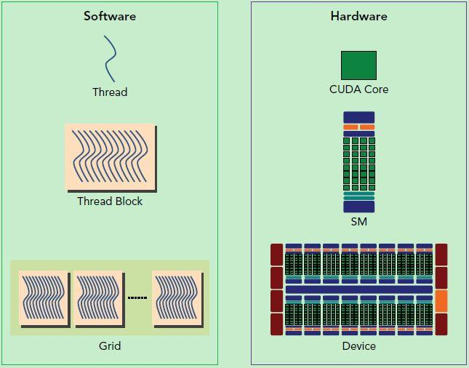
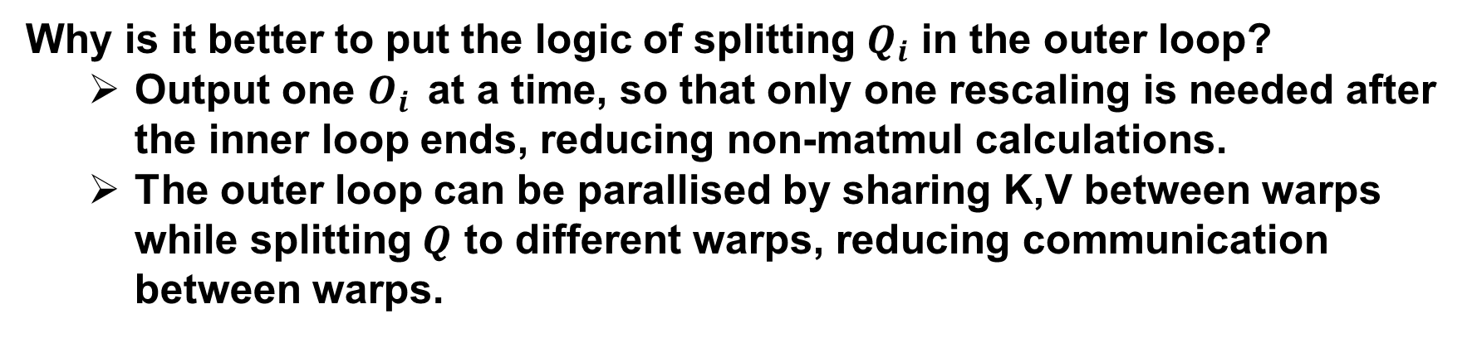
Method
Why is it better to put the logic of splitting $Q_{i}$ in the outer loop?
Output one $O_{i}$ at a time, so that only one rescaling is needed after the inner loop ends, reducing non-matmul calculations.
The outer loop can be parallised by sharing K,V between warps while splitting $Q$ to different warps, reducing communication between warps.
Hierarchy of NVIDIA GPU
GPUs have a bunch of theads to launch kernels
Threads are organized into thread blocks
These blocks are scheduled to run on SMs
Inside each block, threads are grouped into warps

Slide 7
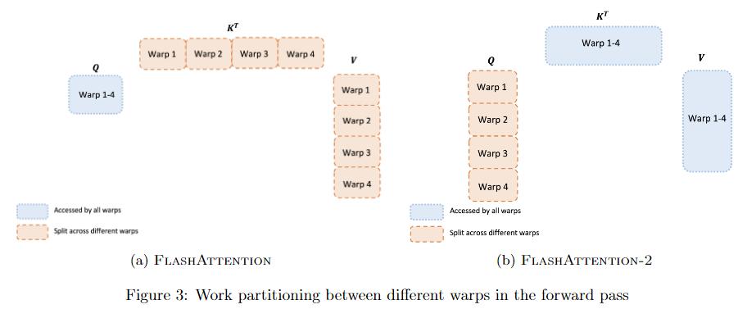
Method
Why is it better to put the logic of splitting $Q_{i}$ in the outer loop?
Output one $O_{i}$ at a time, so that only one rescaling is needed after the inner loop ends, reducing non-matmul calculations.
The outer loop can be parallised by sharing K,V between warps while splitting $Q$ to different warps, reducing communication between warps.
There is no need for communication between warps

Slide 8
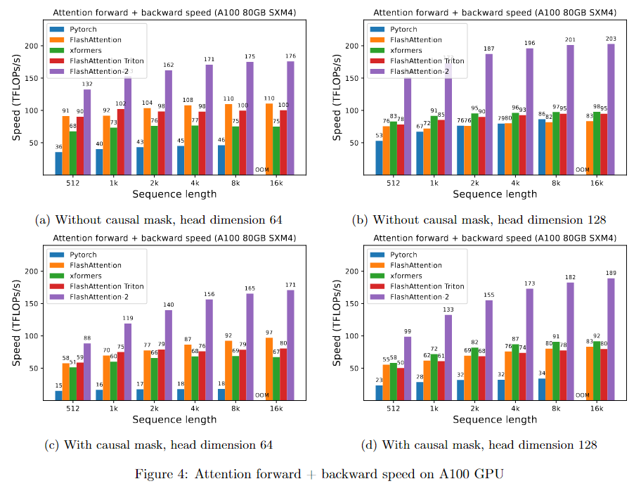
Experiments

Slide 9
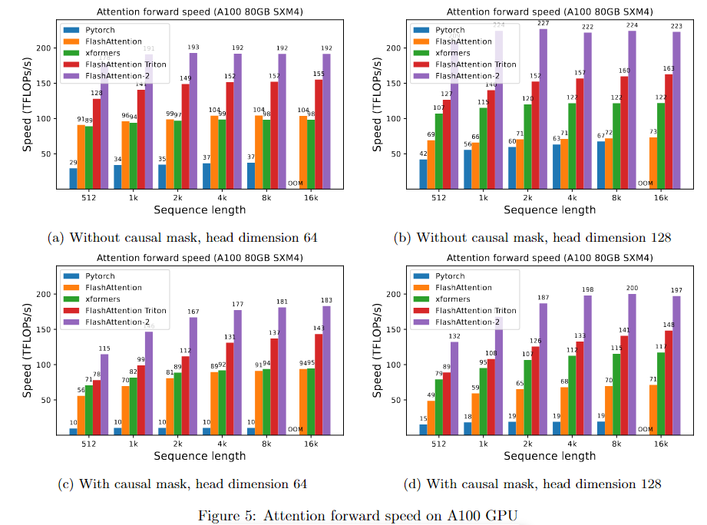
Experiments

Slide 10
Discussion and Future Directions
Inspiration
Software and hardware co-design
Possible future direction
IO-aware deep learning except the attention module
Multi-GPU IO-aware methods

Slide 11


